Slide 1
Day Lily
Design from Weimar Ag Department

Slide 2
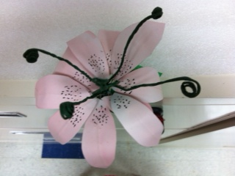
TOP VIEW

Slide 3
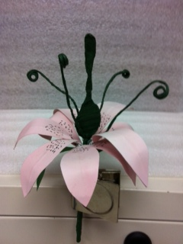
SIDE VIEW

Slide 4
PISTIL
STAMEN

Slide 5
Parts of a Day Lily
Lily has 9 petals, 2 leaves and the Stamen and Pistil
Cut out 18 petals, use a thin piece of wire and glue together.
Color the leaves and put the specks on them before gluing.
Leave enough wire so you can put it around a green pick.
Add the stamen and the Pistil. They’re made of wire and floral tape. Put all together and tape.
My students do this one before making the duct tape flowers. I let them do the duct tape flower in a group, but I select the flower that they will duplicate.

